Slide 1


ACTIVE LEARNING

Slide 2
Introduction

Slide 3
Definition
Active Learning is a machine learning approach where the algorithm selects the most informative data points, then queries an oracle (or some other information source) to label them with the goal of reducing the total amount of data needed to learn the model.

Slide 4
Objective
Learning process optimization by strategically selecting which data points to label.

Slide 5
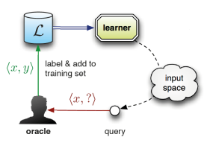
Active learning scenarios
How Data Passed to Model (Nature of Data)
Pool-Based Active Learning
Membership query syntheses
stream based sampling

Slide 6
Active Learning Strategies
Low Confidence Based Sampling
Margin Based Sampling
Entropy Based Sampling
Query by Commit

Slide 7
Methodology

Slide 8
Data Sets
Balanced Datasets
Iris
digits
Imbalanced Datasets
BMI
Used AL scenarios
Pool-Based Active Learning
Appling 4 AL Sampling Strategies
Applying Random Sampling
Compare performance using Evaluation plotting
BMI unbalancing dataset preprocessing using oversampling to make data nearly balanced and increase performance.

Slide 9
Experimental Results

Slide 10
Before active Learning

Slide 11

Iris
Digits
%93
Accuracy
%98
F1-Score
~%98
~%93

Slide 12
After Active Learning

Slide 13
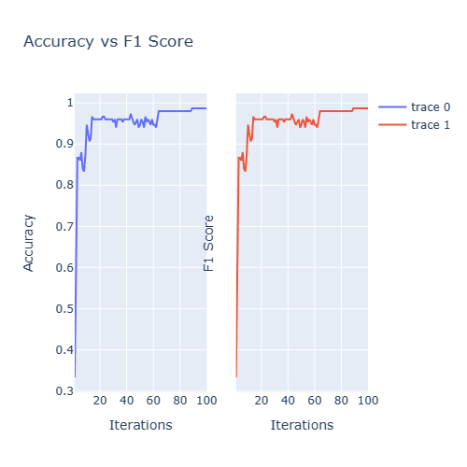
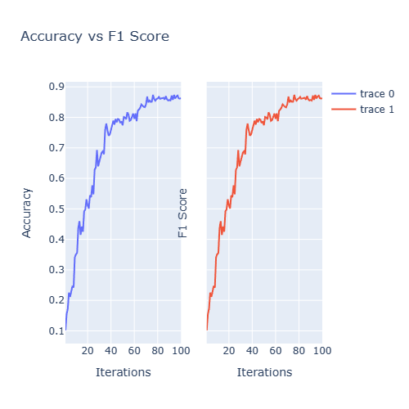
Results on Balanced Datasets
Iris Dataset
Random Sampling
Digits Dataset

Slide 14
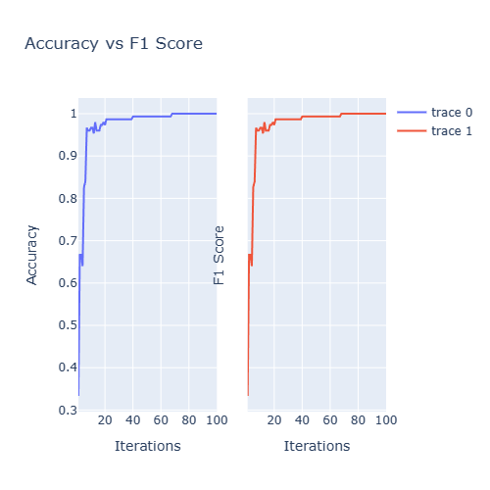
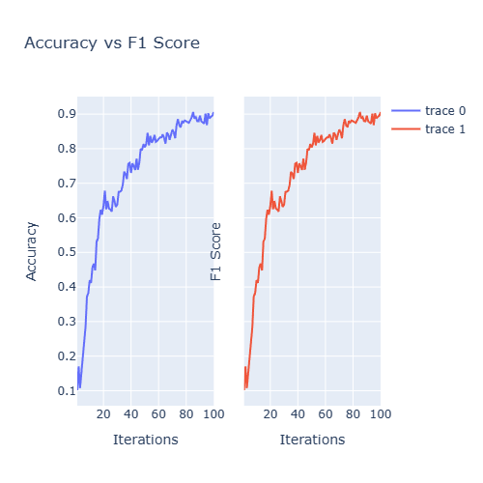
Query By Committee
Iris Dataset
Digits Dataset

Slide 15
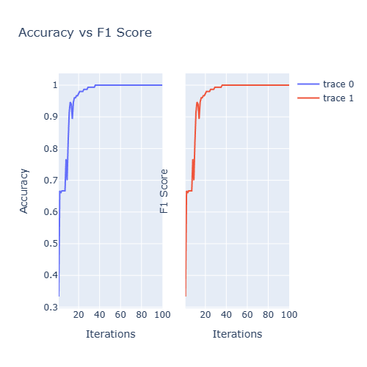
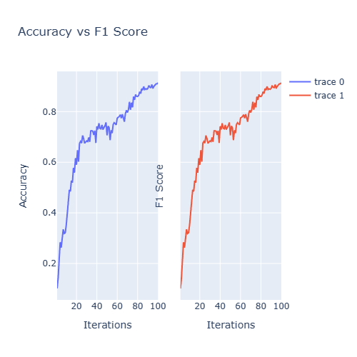
Uncertainty Sampling with Least Confident
Iris Dataset
Digits Dataset

Slide 16
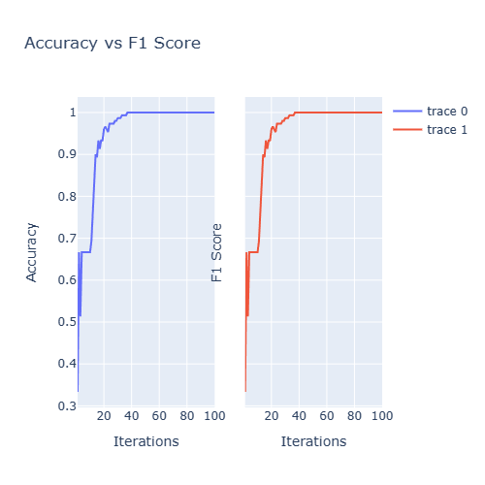
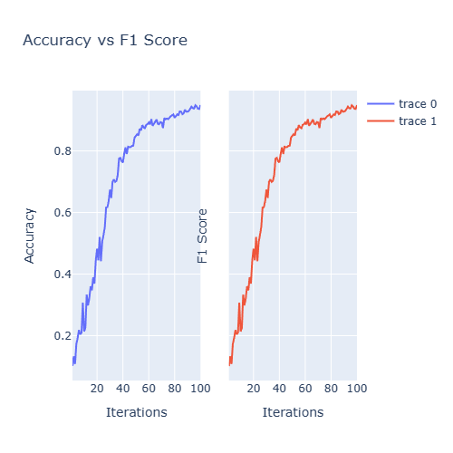
Uncertainty Sampling with Margin Sampling
Iris Dataset
Digits Dataset

Slide 17
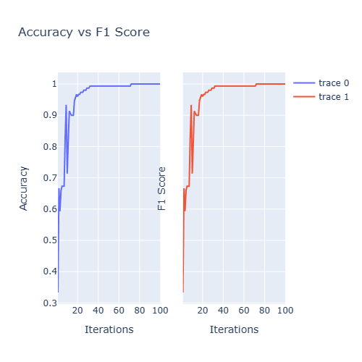
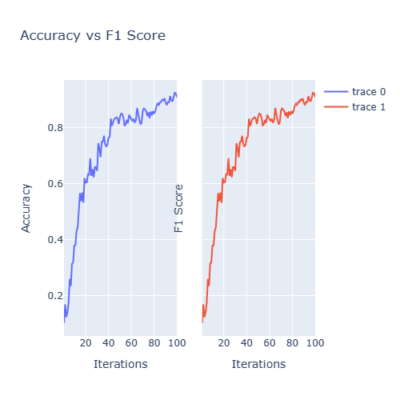
Uncertainty Sampling with Entropy
Iris Dataset
Digits Dataset

Slide 18
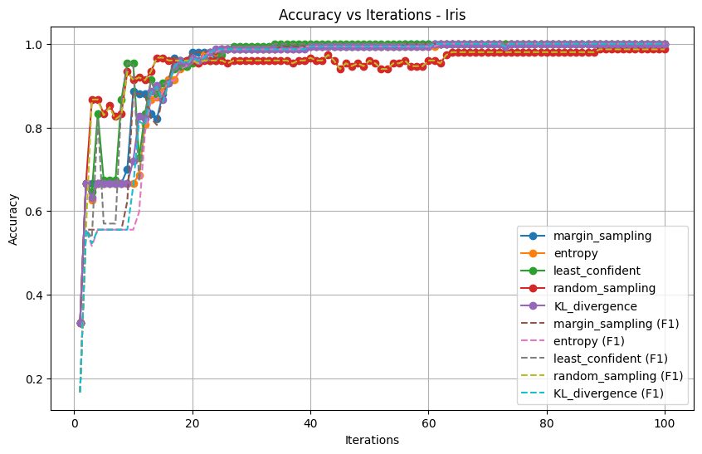
Iris Dataset
Accuracies for dataset: Iris
Method: margin_sampling, Accuracy: 1.0000
Method: entropy, Accuracy: 1.0000
Method: least_confident, Accuracy: 1.0000
Method: random_sampling, Accuracy: 0.9867
Method: KL_divergence, Accuracy: 1.0000
F1-Scores for dataset: Iris
Method: margin_sampling, F1: 1.0000
Method: entropy, F1: 1.0000
Method: least_confident, F1: 1.0000
Method: random_sampling, F1: 0.9867
Method: KL_divergence, F1: 1.0000

Slide 19
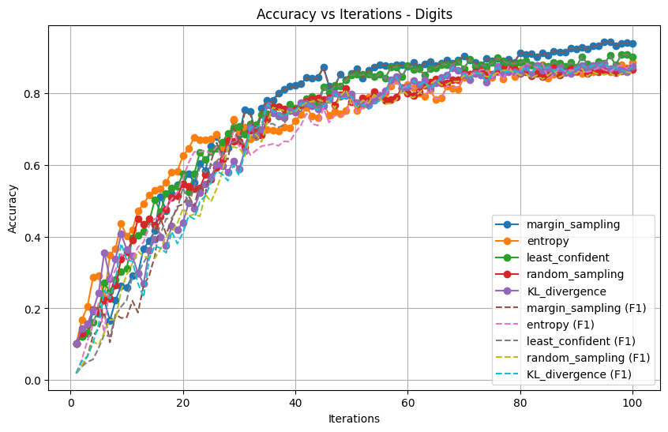
Digits Dataset
Accuracies for dataset: Digits
Method: margin_sampling, Accuracy: 0.9382
Method: entropy, Accuracy: 0.8859
Method: least_confident, Accuracy: 0.9015
Method: random_sampling, Accuracy: 0.8653
Method: KL_divergence, Accuracy: 0.8742
F1-Scores for dataset: Digits
Method: margin_sampling, F1: 0.9386
Method: entropy, F1: 0.8866
Method: least_confident, F1: 0.9017
Method: random_sampling, F1: 0.8566
Method: KL_divergence, F1: 0.8738

Slide 20
Before active Learning

Slide 21
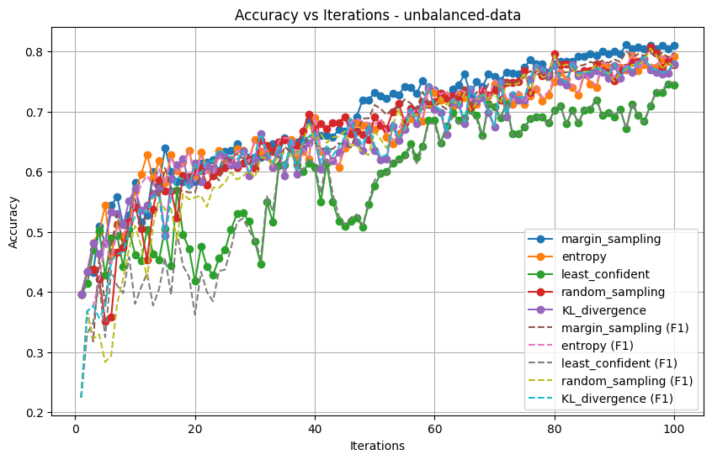
BMI (Unbalanced Dataset)
Accuracies
Method: margin_sampling, Accuracy: 0.8100
Method: entropy, Accuracy: 0.7920
Method: least_confident, Accuracy: 0.7440
Method: random_sampling, Accuracy: 0.7780
Method: KL_divergence, Accuracy: 0.7800
F1
Method: margin_sampling, F1: 0.7979
Method: entropy, F1: 0.7951
Method: least_confident, F1: 0.7470
Method: random_sampling, F1: 0.7728
Method: KL_divergence, F1: 0.7839

Slide 22
After Active Learning

Slide 23
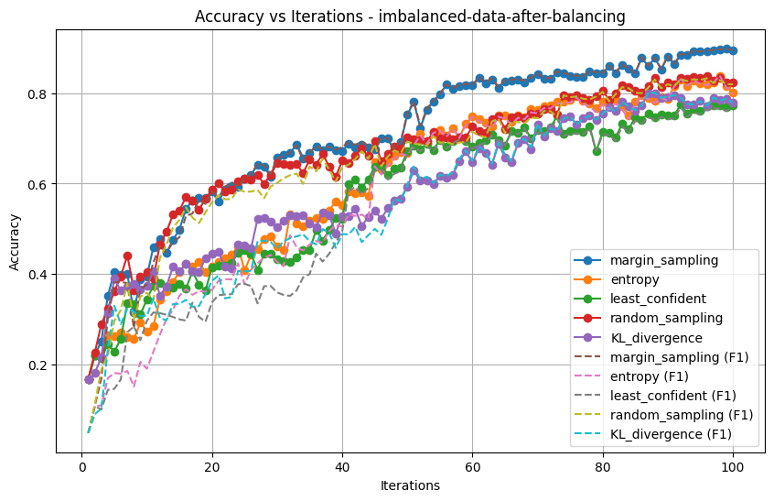
BMI (Unbalanced Dataset)
Accuracies
Method: margin_sampling, Accuracy: 0.8939
Method: entropy, Accuracy: 0.8013
Method: least_confident, Accuracy: 0.7736
Method: random_sampling, Accuracy: 0.8232
Method: KL_divergence, Accuracy: 0.7786
F1
Method: margin_sampling, F1: 0.8947
Method: entropy, F1: 0.7972
Method: least_confident, F1: 0.7668
Method: random_sampling, F1: 0.8197
Method: KL_divergence, F1: 0.7789

Slide 24
Deployment

Slide 25
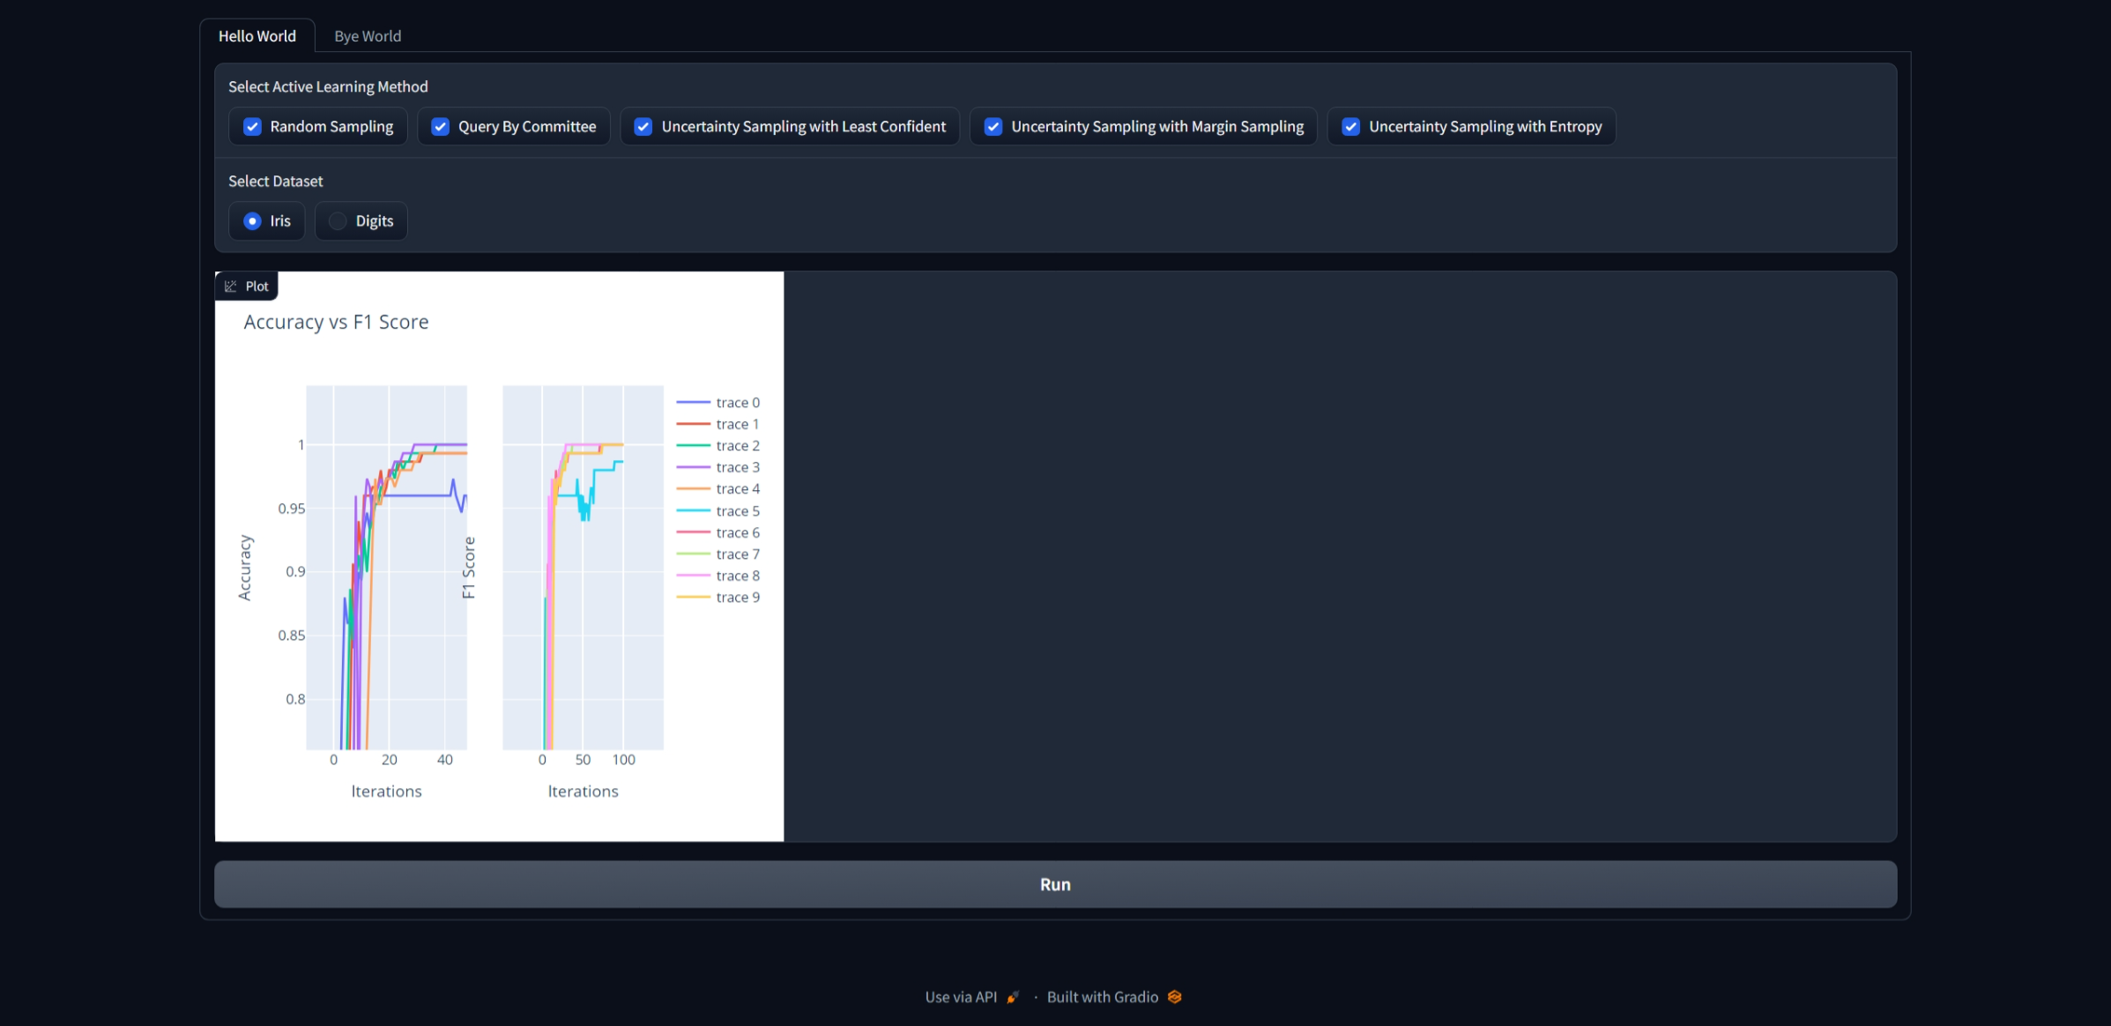

Slide 26
Thank you
Abdelrahman Mostafa Mohamed 20200827
Mohamed Hisham Abdelzaher 20200483
Youssef Mohamed Abdelhay 20200669
Abdelrahman Amin 20200311

